Slide 2

NETWORK DESIGN AND IMPLEMENTATIONS OF STATIC AND DYNAMIC ROUTING WITH PACKET TRACING
by,
Aerroju Akhil
123004008
E.C.E. Branch

Slide 3
What is routing?
Routing is the process of selecting a path for traffic in a network or between or across multiple networks. Broadly, routing is performed in many types of networks, including circuit-switched networks, such as computer networks and he public switched telephone network

Slide 4
How does routing work?
Routers refer to internal routing tables to make decisions about how to route packets along network paths. A routing table records the paths that packets should take to reach every destination that the router is responsible for.

Slide 5
What is Routing Protocols?
Routing Protocols are the set of defined rules used by the routers to communicate between source & destination. They do not move the information to the source to a destination, but only update the routing table that contains the information.
Network Router protocols helps you to specify way routers communicate with each other. It allows the network to select routes between any two nodes on a computer network.

Slide 6
Types of Routing
There are mainly two types of Network Routing
Static
Dynamic

Slide 7
Static and Dynamic Routing Protocols
Static Routing
Dynamic Routing
Static routing is when an administrator manually assigns the path from source to the destination network.
Advantages
No unused bandwidth between links.
Only the administrator is able to add routes
dynamic routing enables routers to select paths according to real-time logical network layout changes.
Advantages:
Easier to configure even on larger networks.
It will be dynamically able to choose a different route in case if a link goes down.

Slide 8
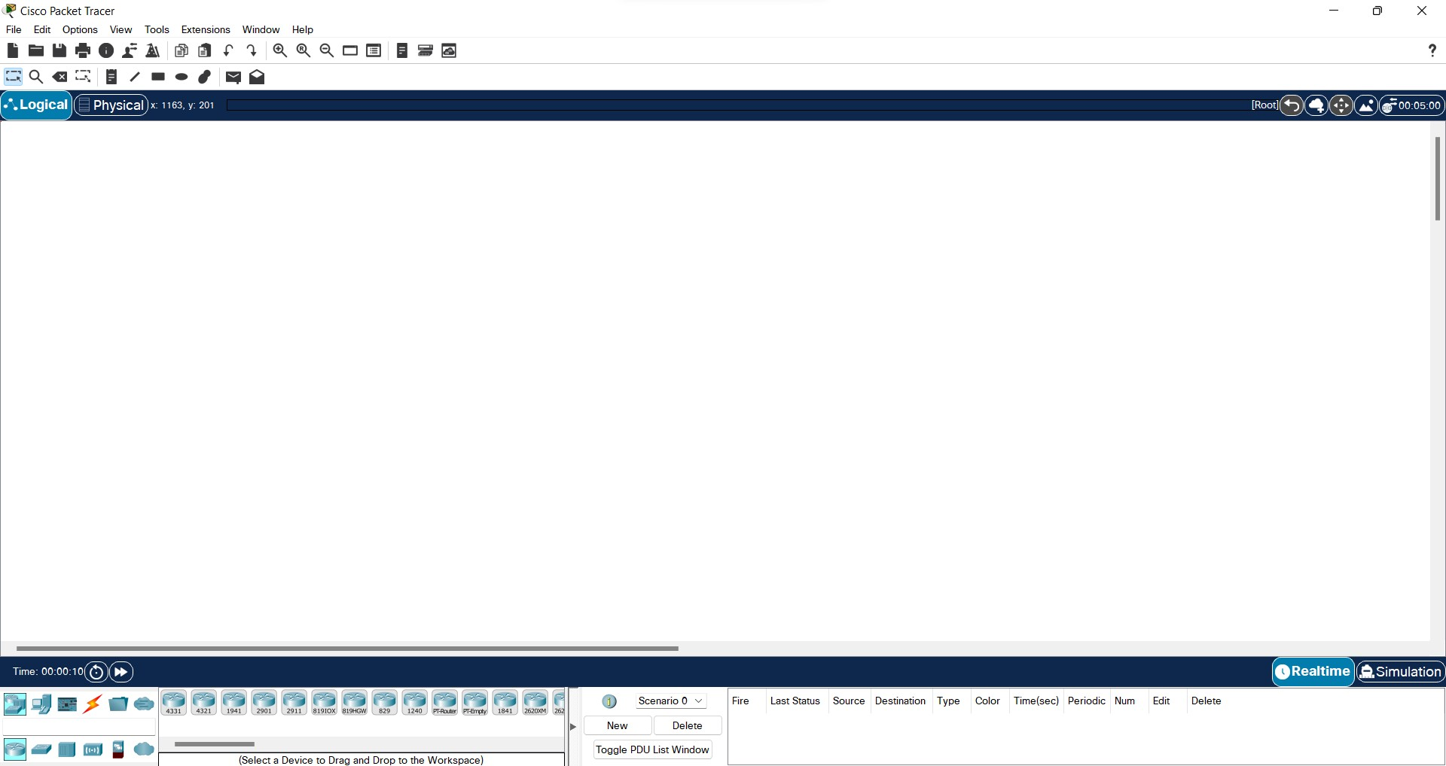
Cisco Packet Tracer
Interface of Cisco Packet Tracer

Slide 9
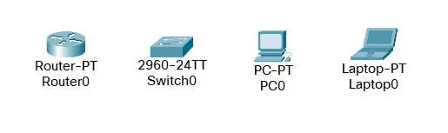
Devices Used in this Project
and also different type of cables

Slide 10
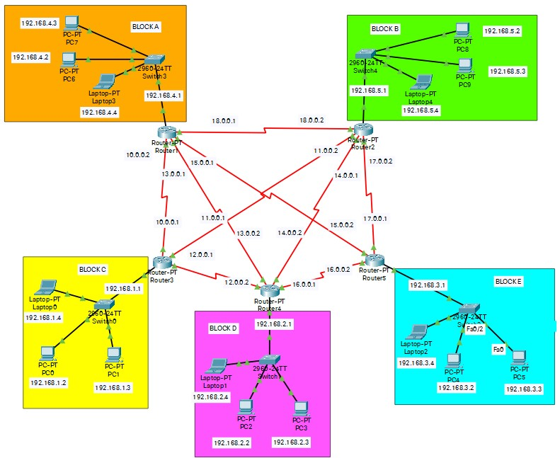
Project design

Slide 11
IP Design Plan for PC’s and Laptops
Device: PC
IP: 192.168.x.y
Subnet Mask: 255.255.255.0
DNS: 192.168.x.1
Where “x” is the network and it is the same for the same block of PC’s and laptops
And “y” is host and greater than 1 and it’s unique for the same set of computers in the block.

Slide 12
IP Design Plan for Routers
Device: Router
Fast Ethernet IPv4: 192.168.x.1
Fast Ethernet Subnet Mask 255.255.255.0
Serial IPv4: z.0.0.(1 or 2 respectively)
Serial Subnet Mask 255.0.0.0
Where “z” is greater than 9
And “x” is the same used in PC

Slide 13
Configuring IP addresses to all PC’s and Routers

Slide 14
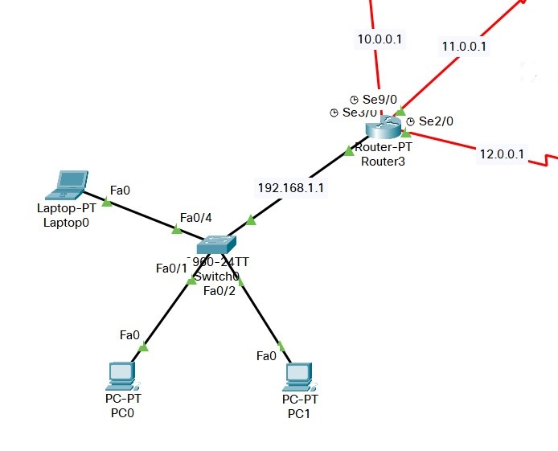
Se3/0 Port status on
IP 10.0.0.1
Se2/0 Port status on
IP 11.0.0.1
Fa0/0 Port status on
IP 192.168.1.1
Fa0/4 Port status on
IP 192.168.1.4
DNS 192.168.1.1
Se2/0 Port status on
IP 12.0.0.1
Fao/1 Port status on
Fa0/2 Port status on
IP 192.168.1.3
DNS 192.168.1.1
IP 192.168.1.2
DNS 192.168.1.1

Slide 15
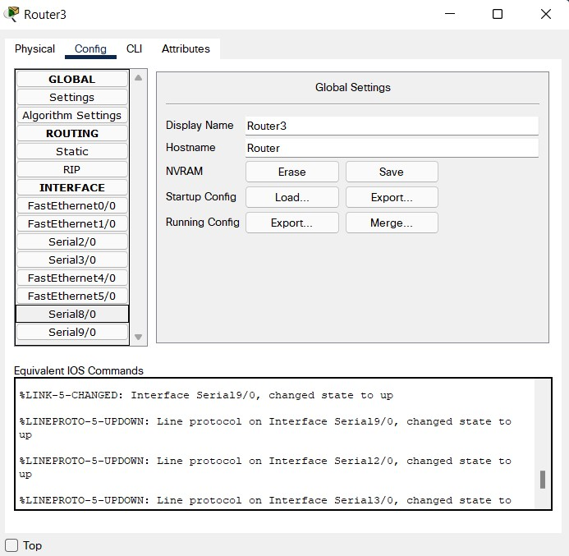


Slide 16
Routing Information Protocol
Routing Information Protocol enables routers to select paths according to real-time logical network layout changes.

Slide 17
How?

Slide 18
Enhanced Interior Gateway Routing Protocol (EIGRP)
Network Performance can be calculated by using Bandwidth(BW) and Delay.
It can be calculated by using,
EIGRP Metric = 256*[10^7/BW(minimum)] + [Sum of Delay]/10
Where BW is Bandwidth.

Slide 19
Adding Network addresses to Routers

Slide 20
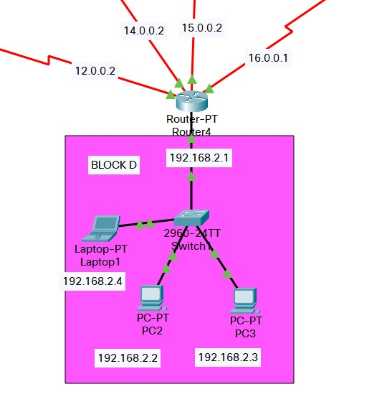
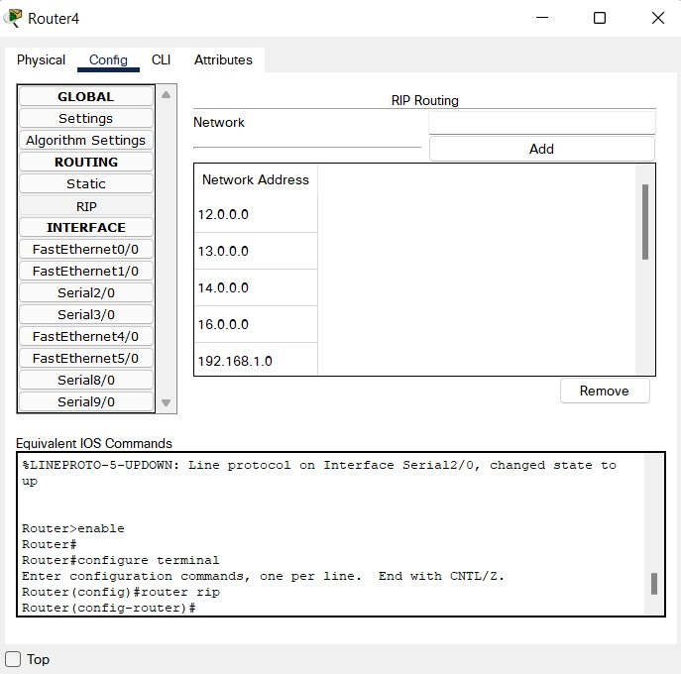
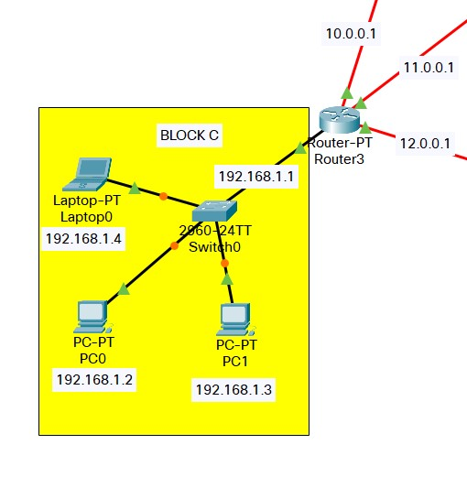
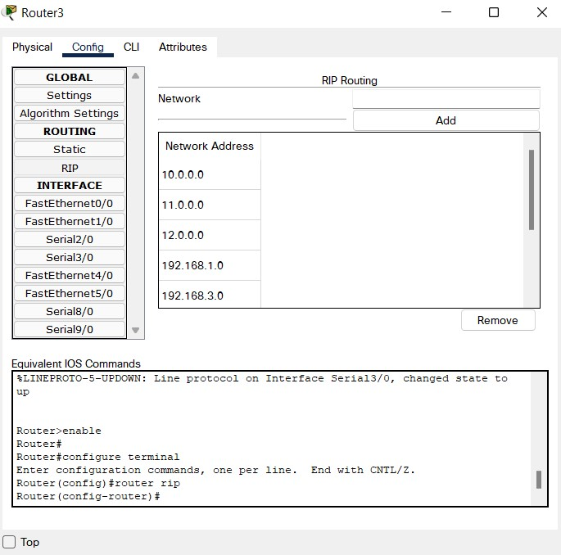

Slide 21
Checking bandwidth and delay

Slide 22
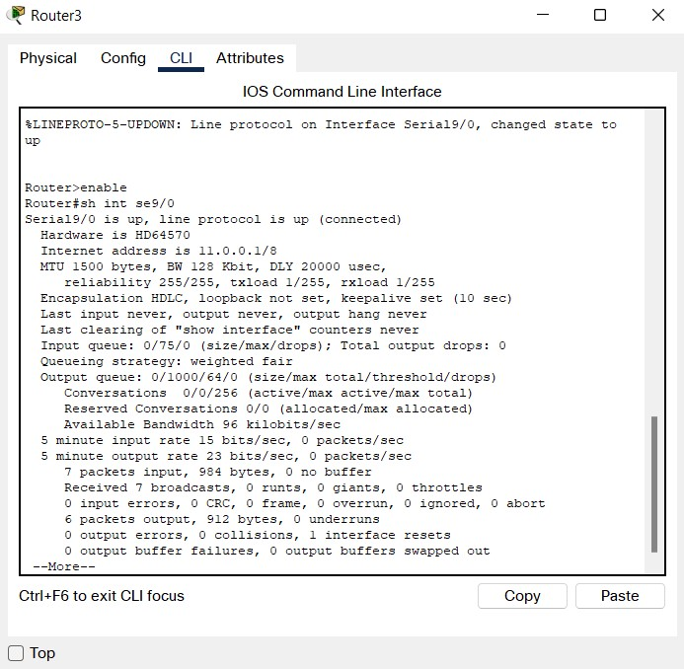
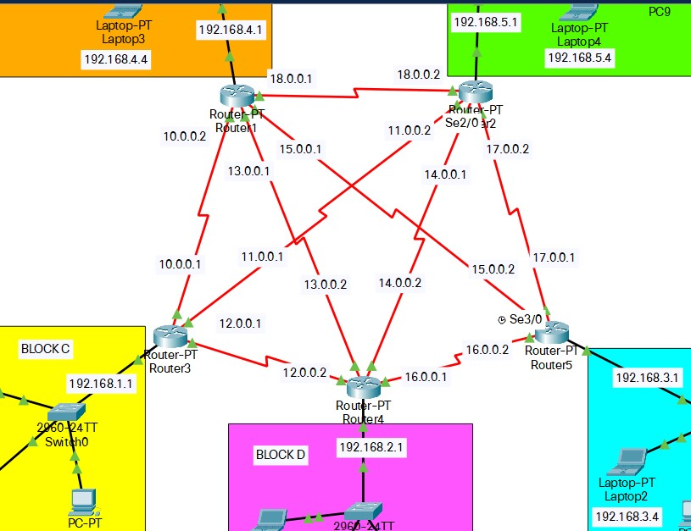
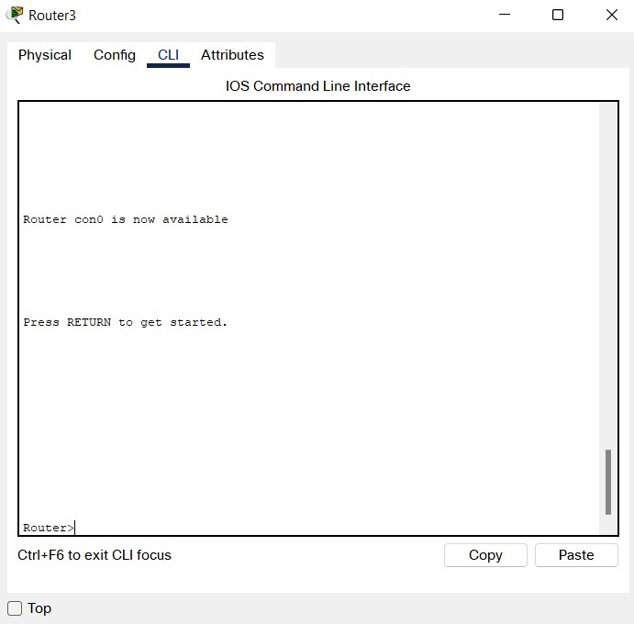
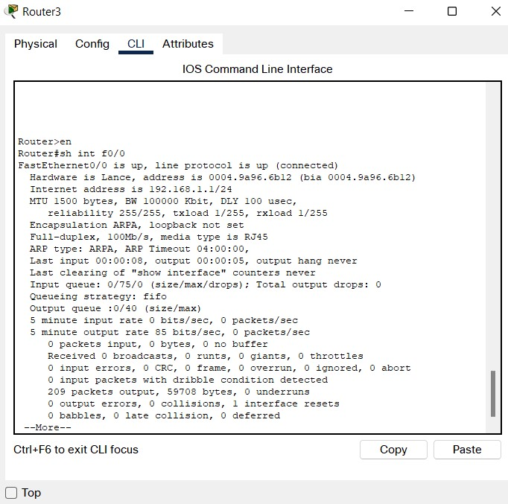
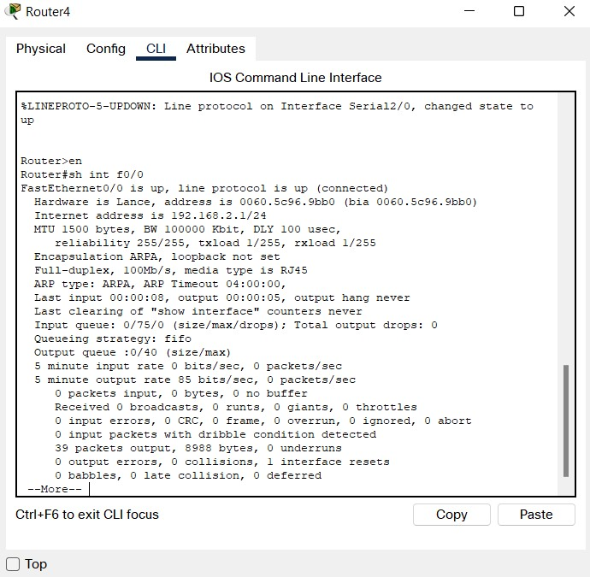

Slide 23
Calculation
Block C-Block B via Block A
EIGRP Metric = 256*[10^7/BW(min)] + [Sum of Delay]/10
= 256*[10^7/128] + [100+2000+2000+100]/10
EIGRP Metric = 710.353 Metric
Block C-Block B
EIGRP Metric = 256*[10^7/BW(min)] + [Sum of Delay]/10
= 256*[10^7/128] + [100+2000+100]/10
EIGRP Metric = 510.353 Metric

Slide 24
Checking Router route

Slide 25
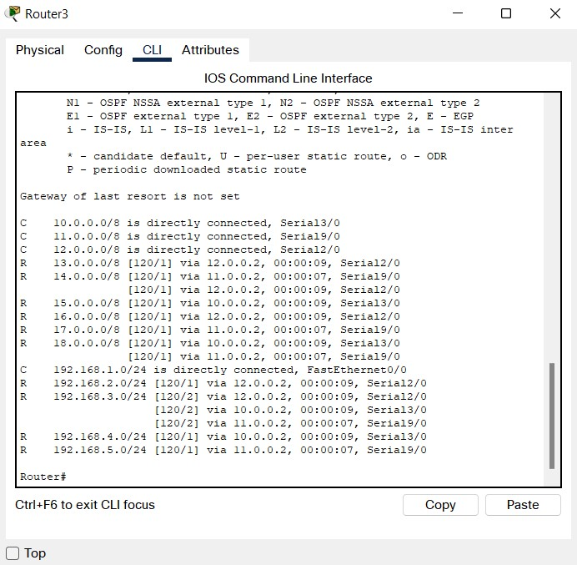

Slide 26
Static Routing
Static routing protocols are used when an administrator manually assigns the path from source to the destination network.

Slide 27
Let’s assign network addresses

Slide 28
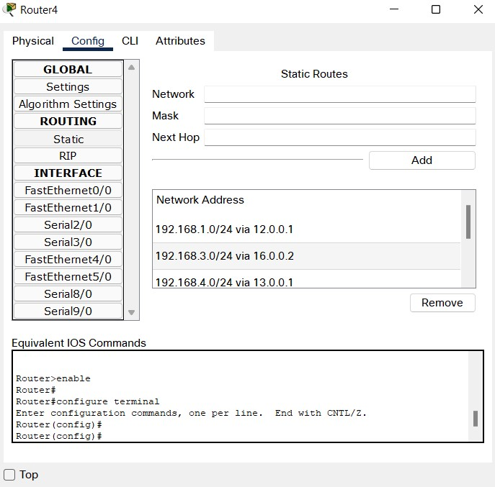
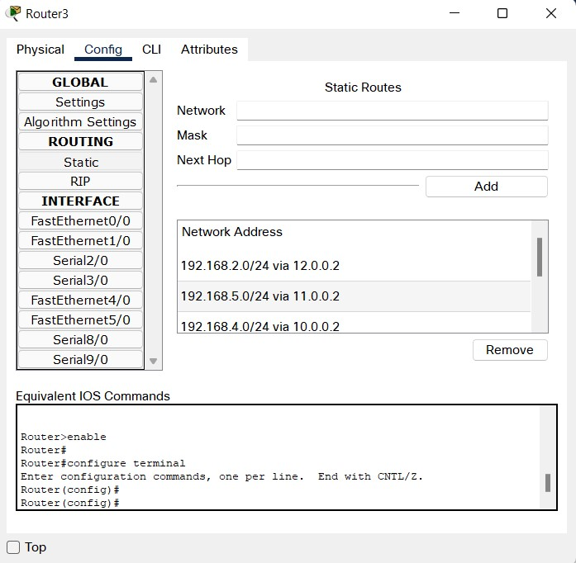
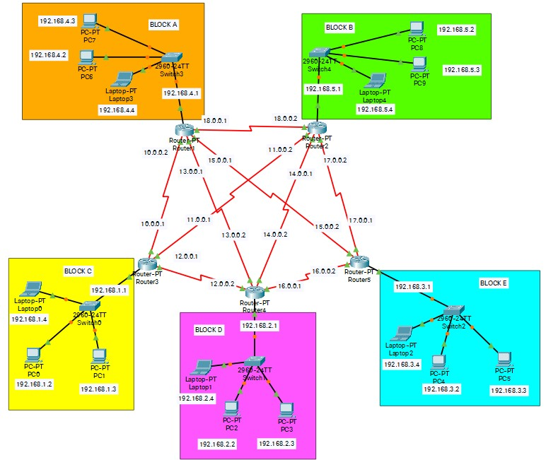

Slide 29
Packet Tracing

Slide 30
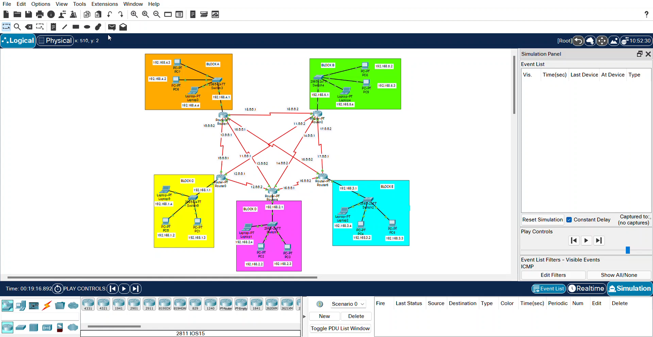

Slide 31
Sending messages from various devices to one device

Slide 32


Slide 34
Thank You,
Project Done and Submitted by
Aerroju Akhil
123004008
E.C.E. Branch

